Slide 1
The effect of dehydration on cognitive abilities
THE BOX OF OBSTRUCTION
Hydrohomies
Roya Gharehbeiklou | Job Maathuis
Mahdiye Nabilou | Hooman Bahrdo
Juan Karina Diaz | Jacob Menzinga

Slide 2
Table of content
THE BOX OF OBSTRUCTION
Research Question
Background information
Methods
Results Interactive Dashboard
Discussion
Future recommendations

Slide 3
Research Question
THE BOX OF OBSTRUCTION
1
Is there a correlation between dehydration and cognitive functioning?

Slide 4
Background Information
THE BOX OF OBSTRUCTION
2

Slide 5
Dehydration
THE BOX OF OBSTRUCTION
We are about 60% water
Body fluids are normally lost through:
Exercise, sweat, tears, urinary system, respiratory or gastrointestinal system.
It has been reported that several aspects of cognitive abilities, such as concentration, short-term memory, long-term memory and alertness can be affected in case of mild to severe dehydration.
Most articles reported a 1.5 -2% of dehydration (body weight loss)
Notes:
Hypotonic, isotonic or hypertonic

Slide 6
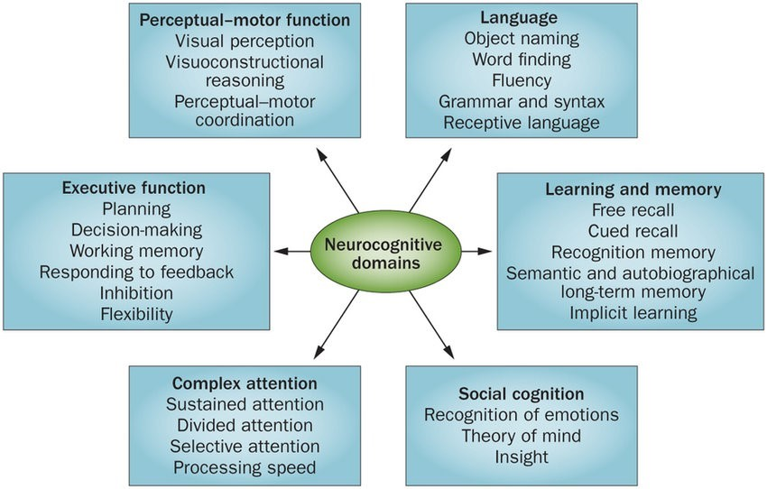
Cognition
THE BOX OF OBSTRUCTION
Split into six domains
Overlap
Sachdev, Perminder & Blacker, Deborah & Blazer, Dan & Ganguli, Mary & Jeste, Dilip & Paulsen, Jane & Petersen, Ronald. (2014). Classifying neurocognitive disorders: The DSM-5 approach. Nature Reviews Neurology.

Slide 7
Hypotheses 1/3
THE BOX OF OBSTRUCTION
Language
We expect the verbal production in words per second to decrease under the influence of dehydration.
Executive function
We expect the accuracy to decrease and the reaction time to under the influence of dehydration.
Notes:
After puberty
Sweating, crying, digesting
20-30% From food

Slide 8
Hypotheses 2/3
THE BOX OF OBSTRUCTION
Perceptual-motor function
We expect the psychomotor reaction time in to increase and accuracy to decrease under the influence of dehydration.
Learning and memory
We expect the recall accuracy to decrease under the influence of dehydration.
Notes:
After puberty
Sweating, crying, digesting
20-30% From food

Slide 9
Hypotheses 3/3
THE BOX OF OBSTRUCTION
Complex attention
We expect the selective attention accuracy to decrease and the reaction time to increase under the influence of dehydration.

Slide 10
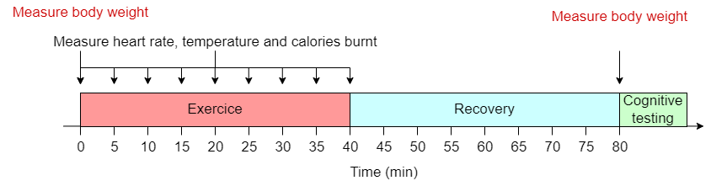
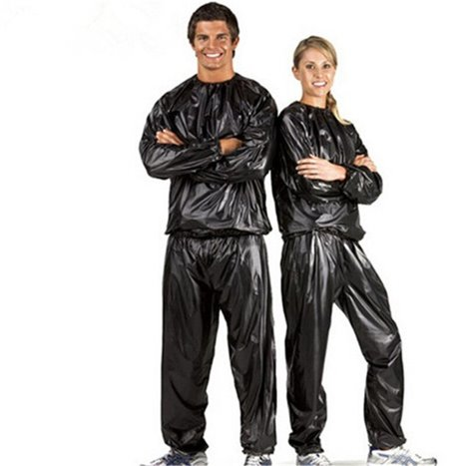

Methods
THE BOX OF OBSTRUCTION
Overview
3

Slide 11
Participant Characteristics
THE BOX OF OBSTRUCTION
Pseudonym | Age | Sex | Medical Backbround
Red | 31 | Female | Nothing to declare
Green | 26 | Female | Nothing to declare
Orange | 23 | Male | Nothing to declare
Pink | 27 | Male | ADHD, no medication
Blue | 29 | Male | Nothing to declare

Slide 12
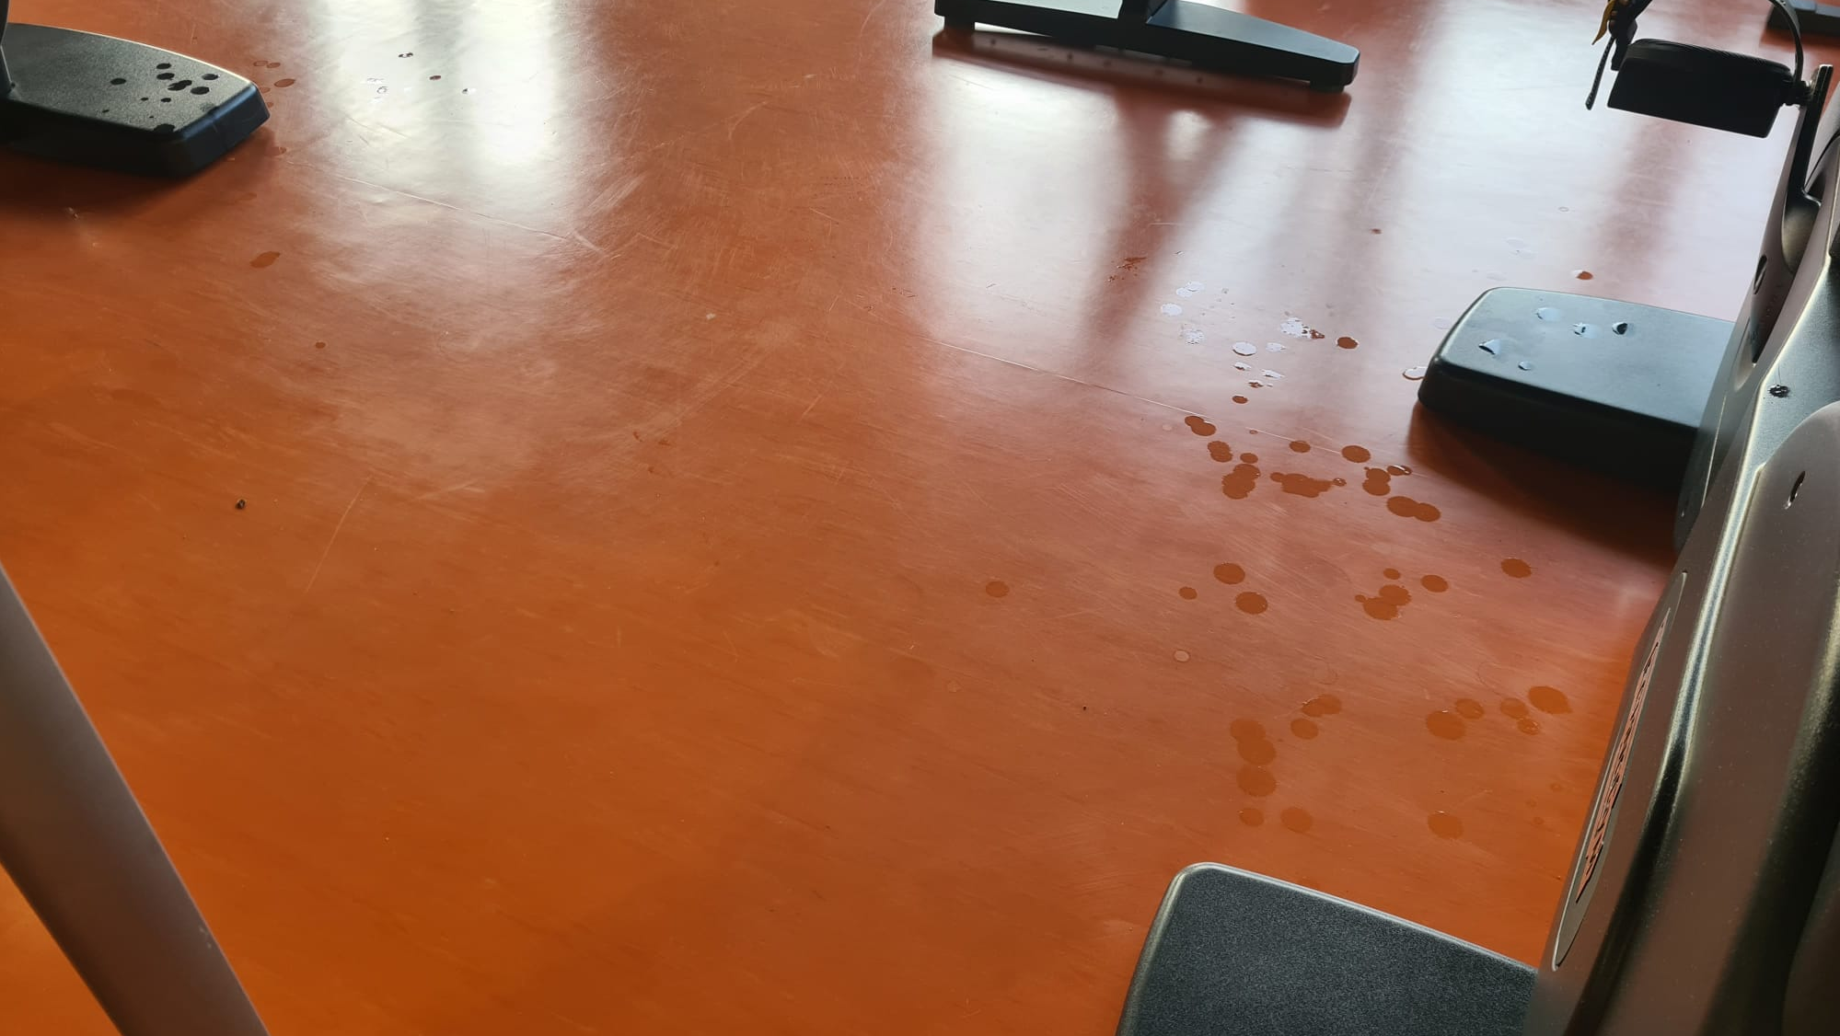
Now for the sweating part
EXERCICE!
THE BOX OF OBSTRUCTION
2 sessions ​ - Control & Dehydration​
​2 repeats

Slide 13
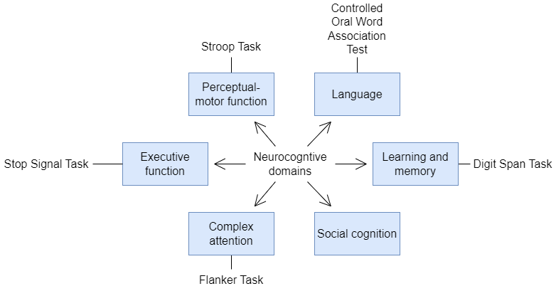
Cognitive tests
THE BOX OF OBSTRUCTION

Slide 14

PsyToolkit
THE BOX OF OBSTRUCTION
"PsyToolkit is a free-to-use toolkit for demonstrating, programming, and running cognitive-psychological experiments and surveys, including personality tests."

Slide 15


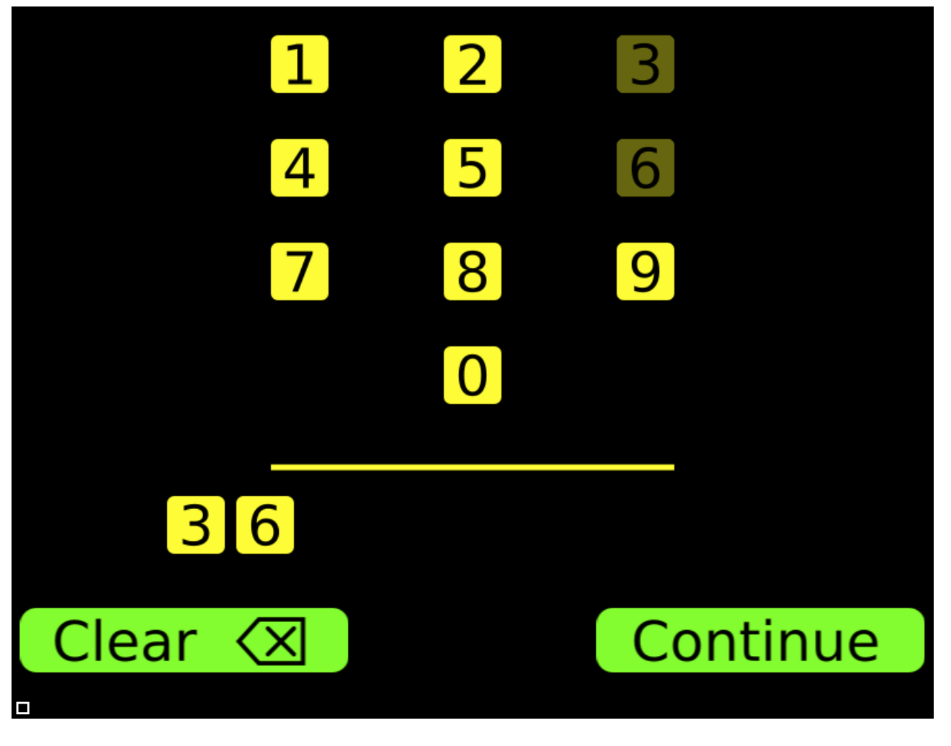
Digit span
THE BOX OF OBSTRUCTION
Participant is asked to reproduce a sequence of numbers

Slide 16




Flanker test
THE BOX OF OBSTRUCTION
Participant responds to a series of 50 stimuli

Slide 17


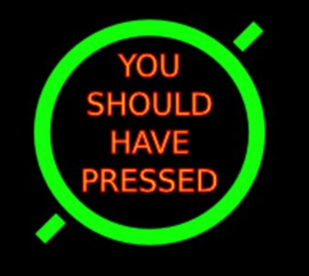
Stop Signal Test
THE BOX OF OBSTRUCTION
First phase:
Quickly press 'B' or 'N' depending on the direction of the arrow shown
Second phase:
Randomly shown a stop signal after the arrow is shown
B
N

Slide 18
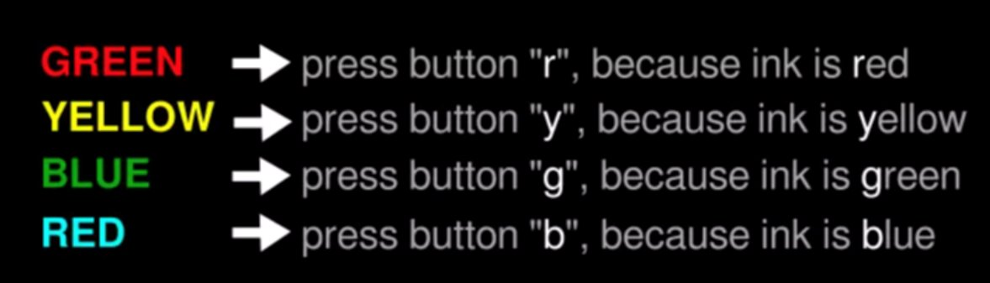
Stroop Test
THE BOX OF OBSTRUCTION

Slide 19
Verbal Fluency Test
THE BOX OF OBSTRUCTION
Adaptation of the CORWAT
60 seconds
One vowel
Two consonant
English

Slide 20
Results
THE BOX OF OBSTRUCTION
4
Let's go to our interactive dashboard.

Slide 21
Dehydration level
THE BOX OF OBSTRUCTION
Participant | Control 1 (%) | Control 2 (%) | Dehydration 1 (%) | Dehydration 2 (%)
Blue | 0.41 | -0.14 | 0.28 | -0.68
Green | -0.32 | 0.34 | -0.97 | -0.66
Red | 0.00 | 0.13 | -0.63 | -0.63
Pink | -0.26 | 0.52 | -0.91 | -1.17
Orange | -0.18 | -0.18 | -1.22 | -1.23

Slide 22
Dashboard

Slide 23
Statistics
THE BOX OF OBSTRUCTION
The validity of the hypotheses are investigated by using different statistical tests

Slide 24
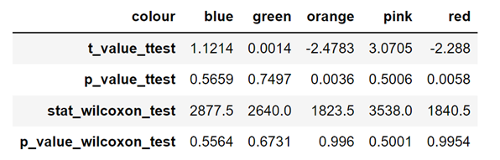
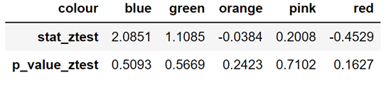
Complex Attention domain
Reaction Time
Correct/Incorrect Answers
Based on the two-sample z test for proportions the alternative hypothesis is rejected
Based on the two-sample t test and Wilcoxon test the alternative hypothesis is approved for participants Red and Orange, but it rejected for others

Slide 25
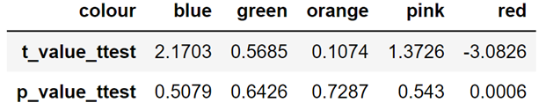
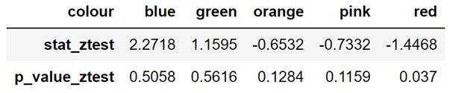
Perceptual-motor Function domain
Reaction Time
Correct/Incorrect Answers
Based on the two-sample t test the alternative hypothesis is approved for participant Red, but it rejected for others
Based on the two-sample z test for proportions the alternative hypothesis is rejected , but it is approved for Red
25

Slide 26
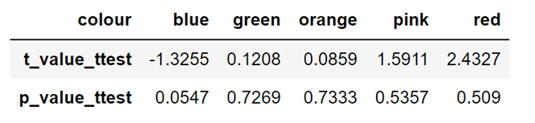
Language domain
Word per test
Based on the two-sample t test the alternative hypothesis is rejected for all the participants. A reason can be sparse datasets.

Slide 27
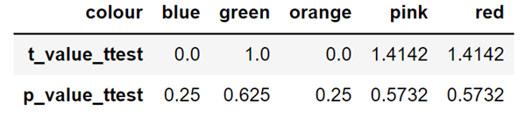
Learning and Memory domain
Sequence length
Based on the two-sample t test the alternative hypothesis is rejected for all the participants. A reason can be sparse datasets.

Slide 28
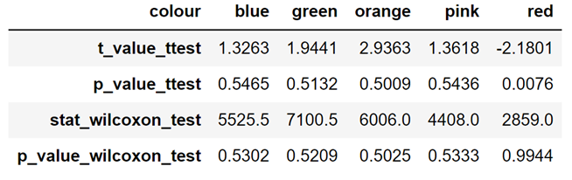
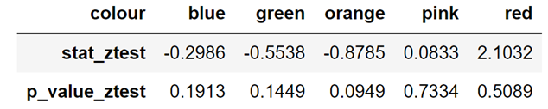
executive function domain
Reaction Time
Correct/Incorrect Answers
Based on the two-sample z test for proportions the alternative hypothesis is rejected
Based on the two-sample t test and Wilcoxon test the alternative hypothesis is approved for participants Red, but it is rejected for others

Slide 29
Discussion
THE BOX OF OBSTRUCTION
5

Slide 30
Weight loss
THE BOX OF OBSTRUCTION
Considerable physical effort -> weight loss goal was hard to achieve in the 40 min of exercise.
Study subjects dehydrated in between 0.66% to 1.23% -> more was needed
Control session -> participants lost weight
drinking less water than is lost through dehydration
Control session -> participant gain weight
drinking more water than is lost through dehydration

Slide 31
Dehydration by exercising
THE BOX OF OBSTRUCTION
Dehydration in control
Not drinking too much during exercise
Measuring the bodyweight right after exercise -> water can be better absorbed in the recovery period
A lot of variability per session, per participant

Slide 32
Participants
THE BOX OF OBSTRUCTION
Factors impacting cognitive functioning
The personal situation of a participant was also not considered.
Stress, food intake.
While exercising -> feeling unwell (being dizzy, dazed)
Dehydration sessions -> feeling tired, unfocused, and having headaches.

Slide 33
Cognitive test
THE BOX OF OBSTRUCTION
Sensitivity of the tests is not determined in this study -> mildly state.
To avoid participants' learning
randomising tests order.
randomising the tests themselves.
alternating the control and dehydration session.
There is not a pattern in the results that indicates that we became better with time.

Slide 34
Conclusions
THE BOX OF OBSTRUCTION
6

Slide 35
THE BOX OF OBSTRUCTION
Dehydration level of 1.2% is not enough to significantly affect your mental abilities.
Low degree dehydration (~0.66%) + exercise could affect the personal wellbeing.
Small sample size + experimental platform + hidden variables + sparse number of test runs can affect the outcome of this research project.
Based on the available experimental results and statistical test outcomes no reliable conclusion can be made about the effect of dehydration on the cognitive abilities.

Slide 36
Future Recommendations
THE BOX OF OBSTRUCTION
5

Slide 37
THE BOX OF OBSTRUCTION
Higher level of dehydration
Sauna??? A control environment, does not require a lot of physical effort and
Wellbeing of the participants need to be taken in account.
More repeats.
Notes:
Try to achieve higher level of dehydration and check the participants cognitive performance.
Sauna??? A control environment, that does not require a lot of physical effort and were the participant could stay a long period of time until the high level of dehydration is achieved. However, the wellbeing of the participants need to be taken in account.
More repeats are also needed to achieve a statistically significant result

Slide 38
Questions?

